Slide 1
영상처리 실제 과제(3주차)
학번:2024254002
성명:전창수

Slide 2
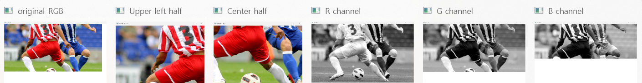
import cv2 as cv
import sys
img = cv.imread("C:\soccer.jpg")
if img is None:
sys.exit('파일을 찾을 수 없습니다.')
cv.imshow('original_RGB', img)
cv.imshow('Upper left half', img[0:img.shape[0]//2, 0:img.shape[1]//2, :])
cv.imshow('Center half', img[img.shape[0]//4 : 3*img.shape[0]//4, img.shape[1]//4 : 3*img.shape[1]//4, :])
cv.imshow('R channel', img[:, :, 2]) # Red channel
cv.imshow('G channel', img[:, :, 1]) # Green channel
cv.imshow('B channel', img[:, :, 0]) # Blue channel
cv.waitKey()
cv.destroyAllWindows()

Slide 3
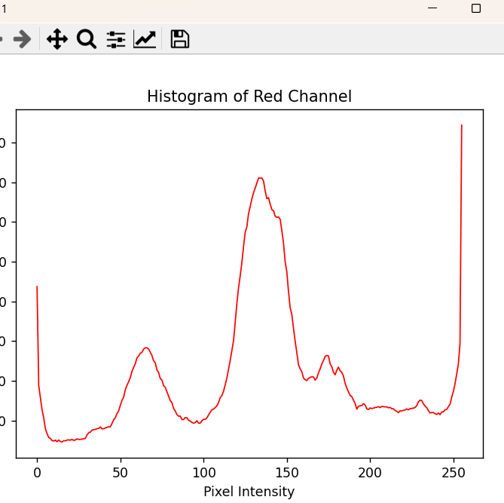
import cv2 as cv
import matplotlib.pyplot as plt
img = cv.imread("C:\soccer.jpg")
h = cv.calcHist([img], [2], None, [256], [0, 256]) # Compute histogram for the Red channel
plt.plot(h, color='r', linewidth=1) # Plot histogram in red
plt.title("Histogram of Red Channel")
plt.xlabel("Pixel Intensity")
plt.ylabel("Frequency")
plt.show() # Display the histogram

Slide 4
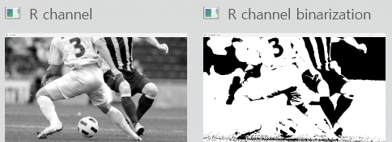
import cv2 as cv
import sys
img = cv.imread("C:\soccer.jpg")
# Check if the image is loaded
if img is None:
sys.exit('파일을 찾을 수 없습니다.') # "Cannot find the file."
# Apply Otsu's thresholding on the Red channel
t, bin_img = cv.threshold(img[:, :, 2], 0, 255, cv.THRESH_BINARY + cv.THRESH_OTSU)
# Print the optimal threshold value
print(f'Otsu’s optimal threshold value: {t}')
# Display the original Red channel and its binarized version
cv.imshow('R channel', img[:, :, 2])
cv.imshow('R channel binarization', bin_img)
cv.waitKey()
cv.destroyAllWindows()

Slide 5
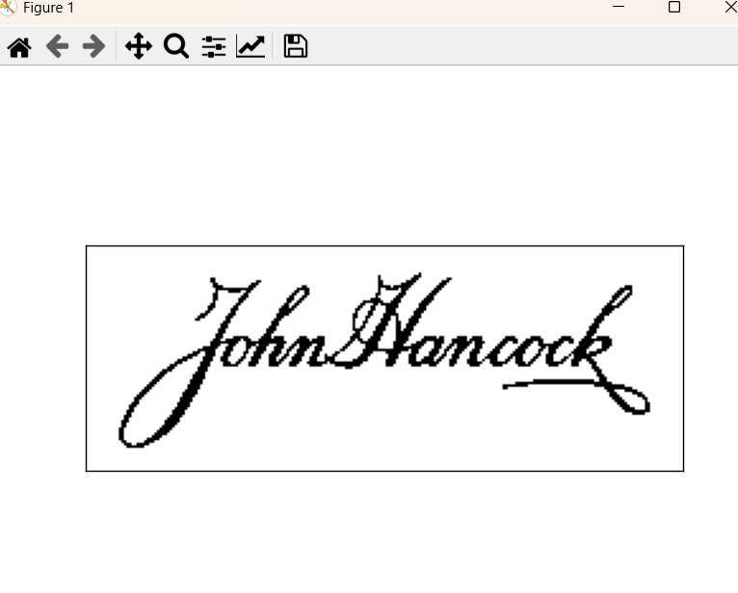
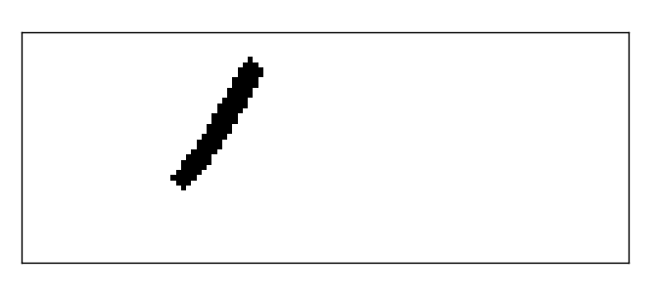
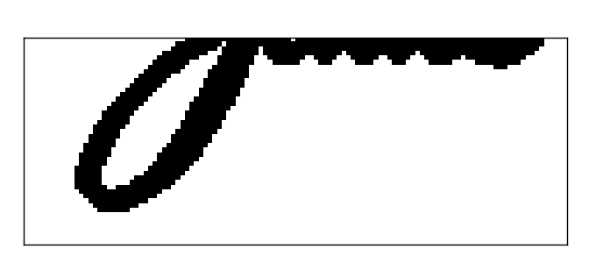
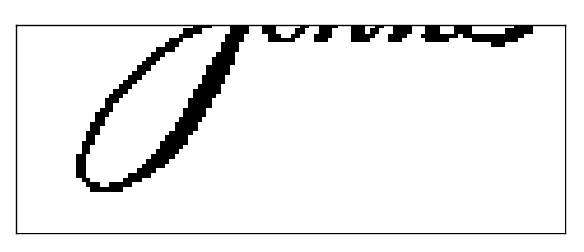
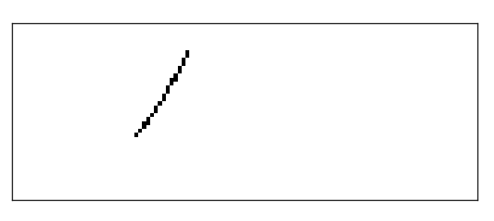
import cv2 as cv
import numpy as np
import matplotlib.pyplot as plt
# Read the image without expecting an alpha channel
img = cv.imread(r"C:\JohnHancocksSignature.jpg", cv.IMREAD_UNCHANGED)
# Select the red channel (or another channel such as green or blue)
t, bin_img = cv.threshold(img[:, :, 0], 0, 255, cv.THRESH_BINARY + cv.THRESH_OTSU)
# Display the binary image
plt.imshow(bin_img, cmap='gray')
plt.xticks([]), plt.yticks([])
plt.show()
# Cropping the binary image
b = bin_img[bin_img.shape[0]//2:bin_img.shape[0], 0:bin_img.shape[1]//2+1]
plt.imshow(b, cmap='gray')
plt.xticks([]), plt.yticks([])
plt.show()
# Define structuring element
se = np.uint8([[0, 0, 1, 0, 0],
[0, 1, 1, 1, 0],
[1, 1, 1, 1, 1],
[0, 1, 1, 1, 0],
[0, 0, 1, 0, 0]])
# Dilation
b_dilation = cv.dilate(b, se, iterations=1)
plt.imshow(b_dilation, cmap='gray')
plt.xticks([]), plt.yticks([])
plt.show()
# Erosion
b_erosion = cv.erode(b, se, iterations=1)
plt.imshow(b_erosion, cmap='gray')
plt.xticks([]), plt.yticks([])
plt.show()
# Closing
b_closing = cv.erode(cv.dilate(b, se, iterations=1), se, iterations=1)
plt.imshow(b_closing, cmap='gray')
plt.xticks([]), plt.yticks([])
plt.show()

Slide 6
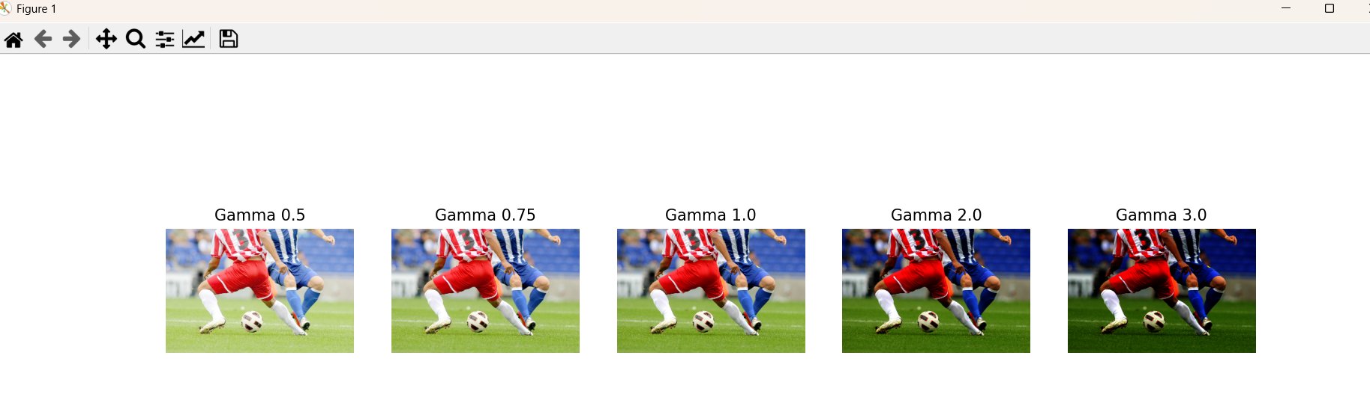
import cv2 as cv
import numpy as np
import matplotlib.pyplot as plt
# Read and resize image
img = cv.imread("C:\soccer.jpg")
img = cv.resize(img, dsize=(0, 0), fx=0.25, fy=0.25)
# Define gamma correction function
def gamma(f, gamma=1.0):
f1 = f / 255.0
return np.uint8(255 * (f1 ** gamma))
# Apply gamma correction with different values
gamma_values = [0.5, 0.75, 1.0, 2.0, 3.0]
gamma_images = [gamma(img, g) for g in gamma_values]
# Display using Matplotlib
fig, axes = plt.subplots(1, len(gamma_values), figsize=(15, 5))
for ax, g, im in zip(axes, gamma_values, gamma_images):
ax.imshow(cv.cvtColor(im, cv.COLOR_BGR2RGB))
ax.set_title(f'Gamma {g}')
ax.axis('off')
plt.show()

Slide 7
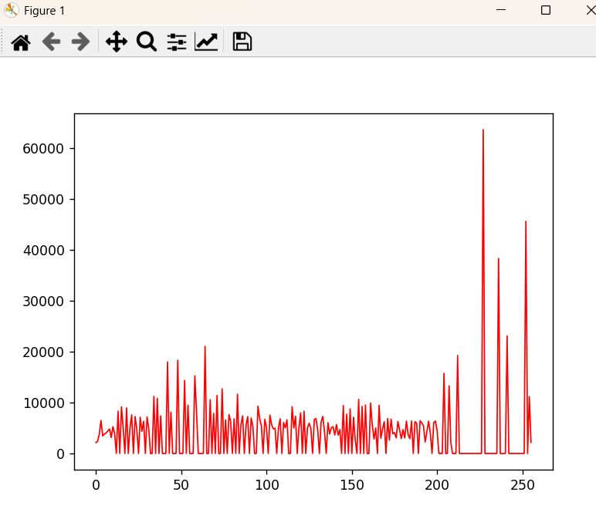
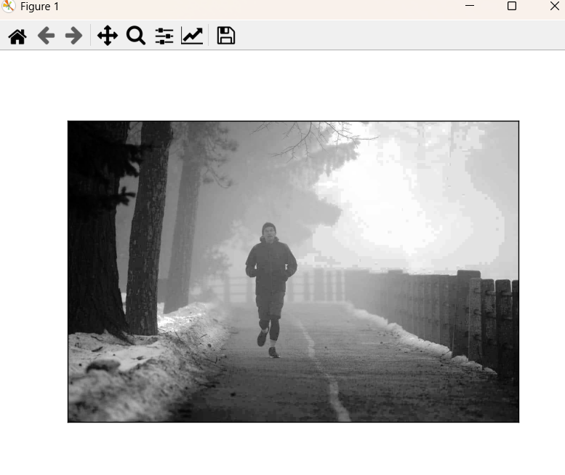
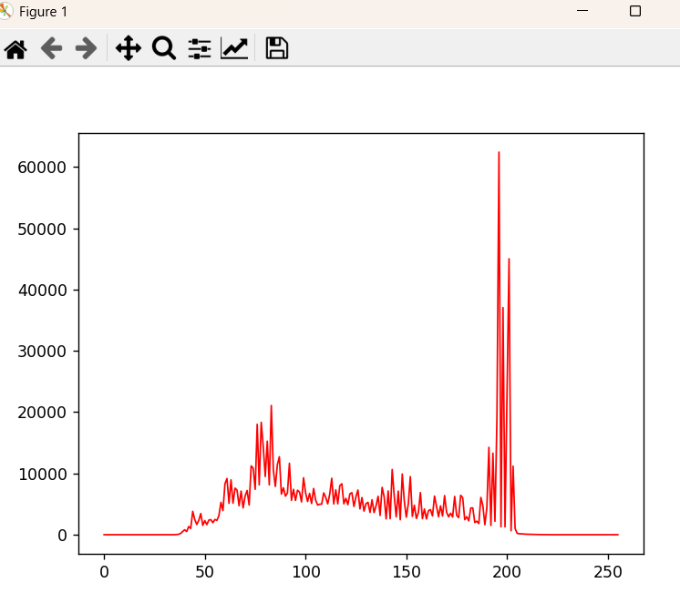
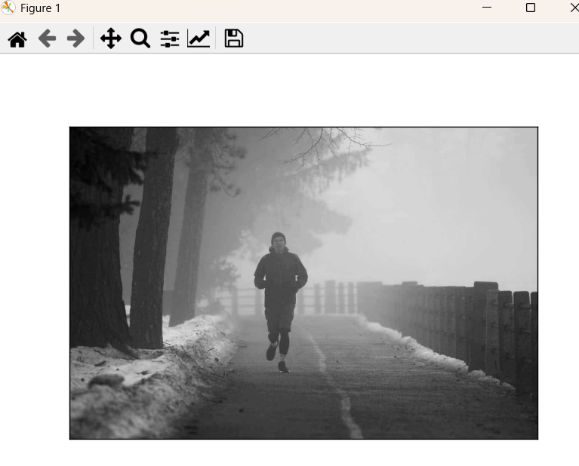
import cv2 as cv
import matplotlib.pyplot as plt
img = cv.imread("C:\mistyload.jpg")
gray = cv.cvtColor(img, cv.COLOR_BGR2GRAY)
plt.imshow(gray, cmap='gray')
plt.xticks([]), plt.yticks([])
plt.show()
h = cv.calcHist([gray], [0], None, [256], [0, 256])
plt.plot(h, color='r', linewidth=1)
plt.show()
equal = cv.equalizeHist(gray)
plt.imshow(equal, cmap='gray')
plt.xticks([]), plt.yticks([])
plt.show()
h = cv.calcHist([equal], [0], None, [256], [0, 256])
plt.plot(h, color='r', linewidth=1)
plt.show()

Slide 8
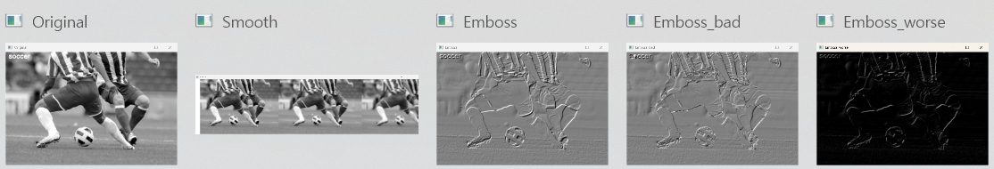
import cv2 as cv
import numpy as np
img = cv.imread("C:\soccer.jpg")
img = cv.resize(img, dsize=(0,0), fx=0.4, fy=0.4)
gray = cv.cvtColor(img, cv.COLOR_BGR2GRAY)
cv.putText(gray, 'soccer', (10,20), cv.FONT_HERSHEY_SIMPLEX, 0.7, (255,255,255), 2)
cv.imshow('Original', gray)
smooth = np.hstack((
cv.GaussianBlur(gray, (5,5), 0.0),
cv.GaussianBlur(gray, (9,9), 0.0),
cv.GaussianBlur(gray, (15,15), 0.0)
))
cv.imshow('Smooth', smooth)
femboss = np.array([
[-1.0, 0.0, 0.0],
[0.0, 0.0, 0.0],
[0.0, 0.0, 1.0]
])
gray16 = np.int16(gray)
emboss = np.uint8(np.clip(cv.filter2D(gray16, -1, femboss) + 128, 0, 255))
emboss_bad = np.uint8(cv.filter2D(gray16, -1, femboss) + 128)
emboss_worse = cv.filter2D(gray, -1, femboss)
cv.imshow('Emboss', emboss)
cv.imshow('Emboss_bad', emboss_bad)
cv.imshow('Emboss_worse', emboss_worse)
cv.waitKey()
cv.destroyAllWindows()

Slide 9
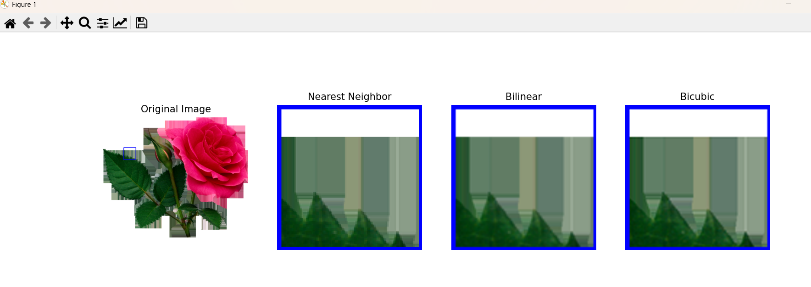
import cv2 as cv
import numpy as np
import matplotlib.pyplot as plt
# Read image (Fix the file path issue)
img = cv.imread(r"C:\rose.png")
# Check if image is loaded properly
if img is None:
raise FileNotFoundError("Image not found. Check the file path.")
# Extract patch (ROI - Region of Interest)
patch = img[250:350, 170:270, :]
# Draw rectangle on the original image
cv.rectangle(img, (170, 250), (270, 350), (255, 0, 0), 3)
# Resize the patch using different interpolation methods
patch_nearest = cv.resize(patch, (0, 0), fx=5, fy=5, interpolation=cv.INTER_NEAREST)
patch_bilinear = cv.resize(patch, (0, 0), fx=5, fy=5, interpolation=cv.INTER_LINEAR)
patch_bicubic = cv.resize(patch, (0, 0), fx=5, fy=5, interpolation=cv.INTER_CUBIC)
# Convert BGR to RGB for correct color display in Matplotlib
img_rgb = cv.cvtColor(img, cv.COLOR_BGR2RGB)
patch_nearest_rgb = cv.cvtColor(patch_nearest, cv.COLOR_BGR2RGB)
patch_bilinear_rgb = cv.cvtColor(patch_bilinear, cv.COLOR_BGR2RGB)
patch_bicubic_rgb = cv.cvtColor(patch_bicubic, cv.COLOR_BGR2RGB)
# Display images using Matplotlib
fig, axes = plt.subplots(1, 4, figsize=(15, 5))
titles = ['Original Image', 'Nearest Neighbor', 'Bilinear', 'Bicubic']
images = [img_rgb, patch_nearest_rgb, patch_bilinear_rgb, patch_bicubic_rgb]
for ax, title, img in zip(axes, titles, images):
ax.imshow(img)
ax.set_title(title)
ax.axis("off")
plt.show()

Slide 10
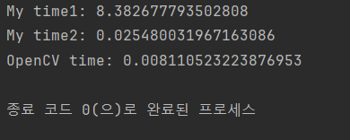
import cv2 as cv
import numpy as np
import time
def my_cvtGray1(bgr_img):
g = np.zeros([bgr_img.shape[0], bgr_img.shape[1]])
for r in range(bgr_img.shape[0]):
for c in range(bgr_img.shape[1]):
# B = bgr_img[r,c,0], G = bgr_img[r,c,1], R = bgr_img[r,c,2]
g[r,c] = 0.114 * bgr_img[r,c,0] \
+ 0.587 * bgr_img[r,c,1] \
+ 0.299 * bgr_img[r,c,2]
return np.uint8(g)
def my_cvtGray2(bgr_img):
# B channel: bgr_img[:,:,0], G channel: bgr_img[:,:,1], R channel: bgr_img[:,:,2]
g = 0.114 * bgr_img[:,:,0] \
+ 0.587 * bgr_img[:,:,1] \
+ 0.299 * bgr_img[:,:,2]
return np.uint8(g)
img = cv.imread("C:\girl_laughing.jpg")
start = time.time()
my_cvtGray1(img)
print('My time1:', time.time() - start)
start = time.time()
my_cvtGray2(img)
print('My time2:', time.time() - start)
start = time.time()
cv.cvtColor(img, cv.COLOR_BGR2GRAY)
print('OpenCV time:', time.time() - start)

